Slide 1

CSA0501-DATABASE MANAGEMENT SYSTEM
Water Tank Monitoring System Using sql triggers constraints and relational schema
PRESENTED BY:
R .HARIKA(192572140)
(CSE-AI DEP)
R.NIHARIKA(192511221)
(CSE DEP)
GUIDED BY:
DR .A.JAYA MABEL RANI

Slide 2


INDEX
ABSTRACT
INTRODUCTION
PROBLEM STATEMENT AND OBJECTIVES
EXISTING SYSTEM AND PROPOSED SYSTEM
METHODOLOGY
MODULES
RESULTS
IEEE STANDARDS
SDG CONTRIBUTION
CONCLUSION
REFERENCES

Slide 3
ABSTRACT
A Water Tank Monitoring System is designed to automatically monitor the water level in a storage tank and control the water pump efficiently.
The system uses an ultrasonic sensor to measure the water level and sends the data to an Arduino for processing.
Purpose of the Project
The Arduino automatically turns the water pump ON when the water level is low and OFF when the tank is full.
Water level, pump status, date, and time are stored in a MySQL database for monitoring and analysis.
The system helps prevent water overflow, avoid dry running of the pump, reduce water wastage, and minimize manual effort.
It provides an efficient, reliable, and cost-effective solution for smart water management in homes, apartments, industries, and agricultural applications.

Slide 4
INTRODUCTION
The Water Tank Monitoring System automatically monitors the water level using an Arduino and Ultrasonic Sensor.
It controls the water pump automatically to prevent overflow and water shortage.
Importance:
Ensures efficient water management.
Prevents water overflow.
Reduces manual effort.
Saves water and electricity.
Stores water level and pump status in a MySQL database.
It provides a simple and reliable solution for homes, industries, and agriculture.

Slide 5
PROBLEM STATEMENTS AND OBJECTIVES
Problem Statement:
Manual water level monitoring is time-consuming.
Water overflow causes wastage.
Pumps may run unnecessarily.
No proper record of water level.
Objectives:
For Monitoring Module:
Measure water level accurately.
Monitor the tank continuously.
For Control Module:
Automatically control the pump.
Store water level and pump status in the database.

Slide 6
EXISTING SYSTEM AND PROPOSED SYSTEMS
Existing System:
Water level is checked manually.
Pump operation depends on the user's observation.
Water overflow and shortages may occur.
No automatic monitoring or database storage.
Requires continuous human intervention.
Proposed System:
Uses an ultrasonic sensor and Arduino for automatic monitoring.
Automatically controls the water pump using a relay module.
Stores water level and pump status in a MySQL database.
Reduces water wastage and manual effort.
Provides efficient and reliable water management.

Slide 7
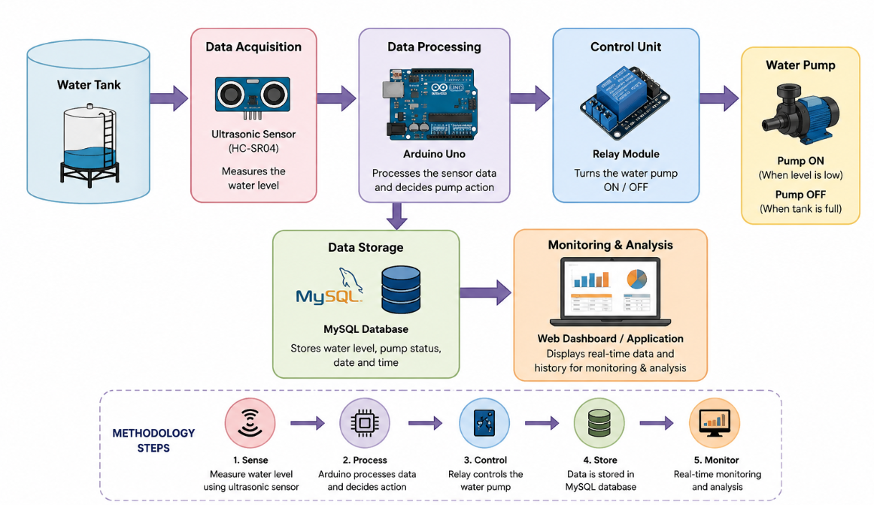
METHODOLOGY

Slide 8
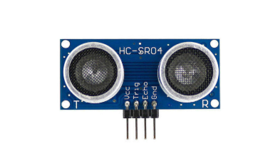
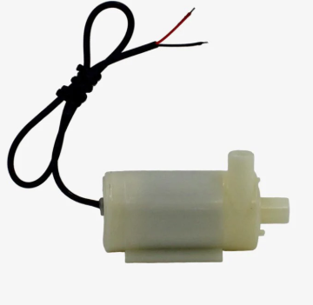
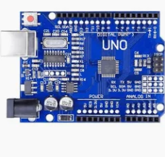
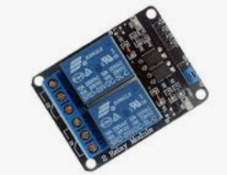
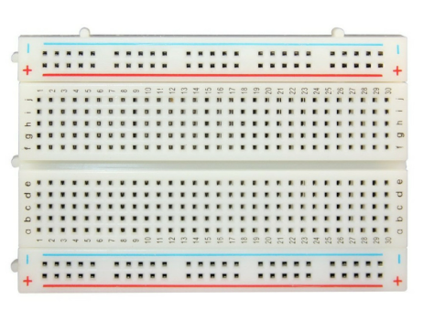
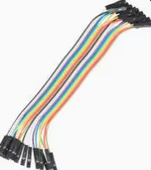
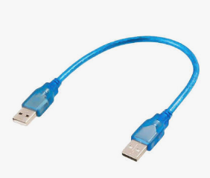
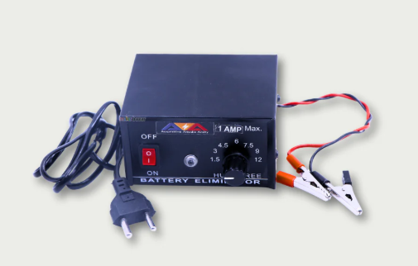
HARDWARE USED
arduino uno
HC-SR04 Ultrasonic Sensor
Relay Module
Mini DC Water Pump
Breadboard
Jumper Wires
USB Cable
Power Supply (5V/12V)

Slide 9
Module -1: Water Level Monitoring
This module continuously monitors the water level using an HC-SR04 Ultrasonic Sensor.
It measures the distance between the sensor and the water surface.
The measured data is sent to the Arduino Uno for processing.
It detects whether the water level is Low, Medium, or Full.
It helps prevent water overflow and water shortage.
Key Functions:
Measures water level.
Sends sensor data to Arduino.
Detects low and full tank conditions.
Provides accurate real-time monitoring.

Slide 10
Module -2: Pump Control and Database Management
This module automatically controls the water pump using a Relay Module.
The Arduino turns the pump ON when the water level is low and OFF when the tank is full.
Water level, pump status, date, and time are stored in a MySQL database.
The stored data can be used for monitoring and analysis.
Key Functions:
Controls pump automatically.
Stores water level and pump status.
Maintains date and time records.
Supports efficient water management.

Slide 11
RESULTS
The ultrasonic sensor accurately detects the water level in the tank.
The Arduino automatically controls the water pump based on the water level.
The relay switches the pump ON when the water level is low and OFF when the tank is full.
Water level and pump status are stored in the MySQL database.
The system helps prevent water overflow and reduces water wastage.
The project minimizes manual monitoring and improves water management.

Slide 12
Output

Slide 13
Comparision RESULTS
Parameter | Existing System | Proposed System
Water Level Monitoring | Manual | Automatic using Ultrasonic Sensor
Pump Control | Manual | Automatic using Relay & Arduino
Water Overflow | May occur | Prevented
Water Wastage | High | Low
Data Storage | No records | Stored in MySQL Database
Accuracy | Moderate | High
Human Effort | High | Low
Efficiency | Low | High

Slide 14
IEEE STANDARDS
1. Sensor Interface Standards
IEEE 1451 – Standard for smart sensors and transducers used for accurate water level measurement.
2. IoT and Smart System Standards
IEEE 2413 – Provides a standard architecture for IoT-based monitoring and smart water management systems.
3. Communication Standards
IEEE 802.3 (Ethernet) or IEEE 802.11 (Wi-Fi) – Supports communication between the monitoring system and database/server (if network-enabled).
4. Electrical and Safety Standards
IEEE C37 Series – Provides electrical safety and protection guidelines for control systems and relay operations.

Slide 15
SDG CONTRIBUTION
SDG 6 – Clean Water and Sanitation
The project helps conserve water by automatically monitoring the water level and preventing tank overflow, ensuring efficient use of water resources.
SDG 9 – Industry, Innovation, and Infrastructure
The system integrates Arduino, sensors, automation, and database technology to provide a smart and reliable water management solution.
SDG 12 – Responsible Consumption and Production
The automatic pump control minimizes water wastage and electricity consumption by operating the pump only when required, promoting responsible resource usage.

Slide 16
Limitations
The system depends on the accuracy of the ultrasonic sensor for measuring water levels.
Sensor readings may be affected by water waves, foam, or obstacles inside the tank.
A continuous power supply is required for uninterrupted operation.
The current system is designed to monitor only a single water tank.
Data is stored in a local MySQL database, making remote access unavailable without IoT integration.
Regular maintenance of the sensor, relay, and water pump is required to ensure reliable performance

Slide 17
RESULTS
The ultrasonic sensor accurately detects the water level in the tank.
The Arduino automatically controls the water pump based on the water level.
The relay switches the pump ON when the water level is low and OFF when the tank is full.
Water level and pump status are stored in the MySQL database.
The system helps prevent water overflow and reduces water wastage.
The project minimizes manual monitoring and improves water management.

Slide 18
Future Enchancement
Integrate IoT for remote monitoring and control through a mobile app.
Store data in a cloud database for real-time access and analysis.
Add SMS/Email notifications when the tank is full or water level is low.
Support monitoring of multiple water tanks from a single system.
Use AI-based water usage prediction to optimize pump operation and save water.
Integrate solar power to make the system more energy-efficient and eco-friendly.

Slide 19
CONCLUSION
The Water Tank Monitoring System provides an efficient and automated solution for monitoring water levels.
It uses an ultrasonic sensor and Arduino to detect the water level and control the water pump automatically.
The system stores water level and pump status in a MySQL database for monitoring and analysis.
It helps prevent water overflow, reduces water wastage, and minimizes manual effort.
Overall, the project offers a reliable, cost-effective, and smart solution for efficient water management in homes, industries, and agricultural applications.

Slide 20
REFERENCES
Arduino. (2025). Arduino Documentation. https://docs.arduino.cc/
Oracle. (2025). MySQL 8.4 Reference Manual. https://dev.mysql.com/doc/
IEEE. (2025). IEEE Xplore Digital Library. https://ieeexplore.ieee.org/
Components101.(2024). HC-SR04 Ultrasonic Sensor. https://components101.com/sensors/ultrasonic-sensor-working-pinout-datasheet
Circuit Digest. (2024). Arduino-Based Water Tank Level Monitoring System. https://circuitdigest.com/
Electronics Hub. (2024). Water Level Monitoring using Arduino and Ultrasonic Sensor. https://www.electronicshub.org/

Slide 21
THANK YOU

